Slide 1
International law, EU and key technologies: what about AI in outer space?
Meeting with Alumni: new professional frontiers
Outreach activity | International Law course | Bachelor in Political Science
Dialogue with dr. Tommaso DEL BECARO
Moderator: Prof. Claudia CINELLI
University of Pisa
Teaching assistant: Dr. Camilla CAMPODONICO
University of Genoa
1 April 2025 | 12:15-13:45 | B2 Polo Piagge
Contact person: camilla.campodonico@edu.unige.it

Slide 2
WHY DO WE NEED TO REGULATE OUTER SPACE?
From an “old” to a “new” space era
Old space era
Dominated by two Superpowers during the Cold war.
New space era
Numerous state and private actors;
Cost reduction for access to space and miniaturization of critical components;
New Space Economy.

Slide 3
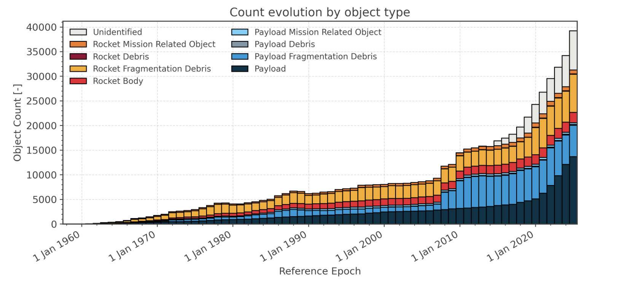
Picture from ESA

Slide 4
What is space LAW?
A branch of international law governing activities in outer space. Its cornerstone is the collection of five major international treaties:
The Treaty on Principles Governing the Activities of States in the Exploration and Use of Outer Space, including the Moon and Other Celestial Bodies (Outer Space Treaty, 1967)
The Agreement on the Rescue of Astronauts, the Return of Astronauts and the Return of Objects Launched into Outer Space (Rescue Agreement, 1968)
The Convention on International Liability for Damage Caused by Space Objects (Liability Convention, 1972)
The Convention on Registration of Objects Launched into Outer Space (Registration Convention, 1975)
The Agreement Governing the Activities of States on the Moon and Other Celestial Bodies (Moon Agreement, 1979)

Slide 5
What is the legal status of outer space?
The legal status of outer space is characterized as an international space existing beyond national jurisdictions and governed by international law. The Outer Space Treaty establishes that outer space is res communis omnium which means it cannot be subject to national appropriation or claims of sovereignty.
As an international space, outer space is free for exploration and use by all states on the basis of equality and without discrimination. Article I of the OST declares that this exploration and use shall be carried out for the benefit and interests of all countries, regardless of their economic or scientific development. However, this freedom comes with restrictions and obligations - states must conduct their activities in accordance with international law, including the UN Charter, and maintain international peace and security.

Slide 6
What are the fundamental principles governing outer space?
NON-APPROPRIATION:
The principle of non-appropriation (Article II of the OST) explicitly states that outer space, including the Moon and other celestial bodies, is not subject to national appropriation by any means, whether through claims of sovereignty, occupation, or any other form of unilateral control.
The legal rationale behind this principle is to prevent territorial disputes and ensure that no state gains exclusive ownership over extraterrestrial resources or territories, fostering cooperation rather than competition that could lead to conflict.

Slide 7
What are the fundamental principles governing outer space?
PEACEFUL USE:
The principle of peaceful use is embedded in Article IV of the OST, which prohibits the placement of nuclear weapons or any other weapons of mass destruction in orbit, on the Moon, or on any other celestial body. It also restricts the use of the Moon and other celestial bodies exclusively to peaceful purposes.
While peaceful is generally understood as "non-aggressive," it does not necessarily mean "non-military," since military technology can still be used for scientific research and other permitted activities in space.

Slide 8
Artificial intelligence
MISALIGNMENT BETWEEN TECHNOLOGICAL EVOLUTION AND THE CORPUS IURIS SPATIALIS

Slide 9
EU & IA in space
AI-driven applications are revolutionizing multiple areas e.g.:
High-precision environmental monitoring and predictive analysis of Earth observation data: Copernicus (EUSPA) leverages AI to process data from sentinel satellites, detecting climate changes, pollution, deforestation, and natural disasters with high accuracy.
Automated traffic management of satellites in increasingly congested orbits; AIOps (ESA) combines big data and machine learning to automate IT operations, including problem detection, analysis, and resolution. This translates to more efficient data processing, predictive maintenance of spacecraft systems, and enhanced decision-making processes in the space industry.
Optimizing the sustainability of space operations through predictive manteinance and energy management systems; AIOps
Communications optimization: SDN for SatCom (Software-Defined Networking for Satellite Communications –ESA) project applying AI to 5G satellite networks, enhancing signal transmission and real-time traffic adaptation.

Slide 10
RETHINKING THE SPACE OBJECT: LIABILITY IN THE AI ERA
Two fundamental criticalities:
The inadequacy of the definition of “space object” in the AI era;
The ambiguity in determining liability for AI-powered objects.

Slide 11
WHAT IS A SPACE OBJECT?
“component parts of a space object and its launch vehicle and parts thereof”*
Can we consider a space object an object that is not launched into space?
Is an autonomous AI-controlled satellite still considered a "space object" under current conventions?
Can we apply an evolutionary interpretation in light of art. 31 of the Vienna Convention on the Law of Treaties?
*Art. I Liability Convention & Registration Convention

Slide 12
LIABILITY IN THE AI ERA
Outer Space Treaty
Art. VI: States are internationally responsible for national space activities, whether conducted by governmental or non-governmental entities. he activities of non-governmental entities in outer space, including the moon and other celestial bodies, shall require authorization and continuing supervision by the appropriate State Party to the Treaty.
Liability Convention
Art. II: strict liability for damage caused by space objects on the earth’s surface or to aircraft in flight, and fault liability for damage caused elsewhere.

Slide 13
LIABILITY IN THE AI ERA
What constitutes "continuous supervision" when AI operates with increasing degrees of autonomy?
How do we define "fault" in a distributed, algorithmic decision-making system?
How do we assess "damage" when harmful action stems from machine learning decisions not immediately traceable to a single human agent?

Slide 14
LIABILITY IN THE AI ERA
The complexity of AI systems in space technologies challenges traditional legal frameworks due to three key characteristics:
decentralized, distributed decision-making through machine learning algorithms and multi-agent systems,
intricate multi-jurisdictional control architectures involving sophisticated networks like satellite mega-constellations, and
the difficulty of applying traditional "standard of care" concepts to rapidly evolving technologies without historical precedents. Particularly challenging is interpreting the Outer Space Treaty's requirements of "authorization and continuing supervision" in the context of autonomous, interconnected ML systems operating across different legal domains.

Slide 15
Questions?

